Slide 1

Information Technology

Slide 2
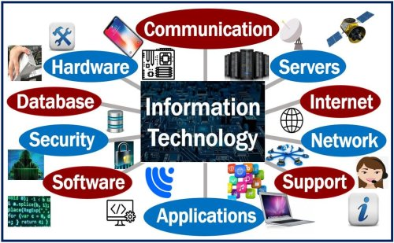
Careers In I.T. | Overview
What is Information Technology (I.T.):
Information technology is the broad subject concerned with all aspects of managing and processing information, especially within a large organization or company.
While IT is often used to describe computers and computer networks, it actually includes all layers of all systems within an organization — from the physical hardware to the operating systems, applications, databases, storage, servers and more.

Slide 3



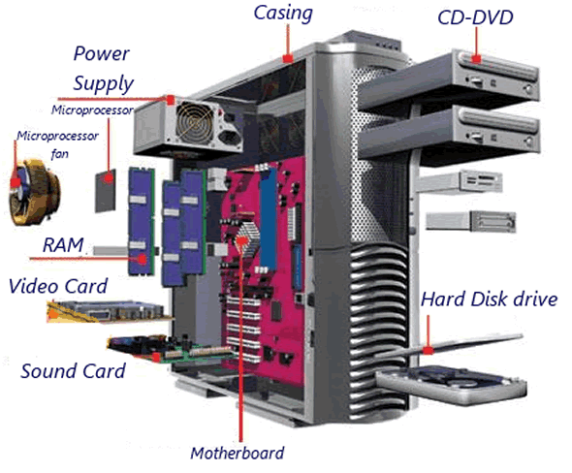


Careers In I.T. | Dominance Factors
The dominance of the IT job market is due in part to numerous factors including:
Growth of the Internet E-Commerce
Lower hardware & software prices Demand for digital security

Slide 4
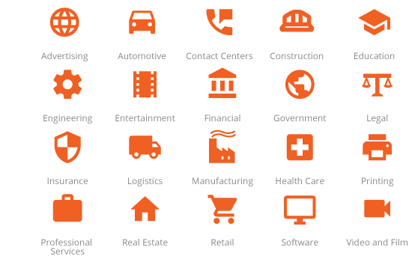
Careers In I.T. | Industries
As an IT practitioner, you can work across all industries

Slide 5
Careers in I.T. Data Analytics

Slide 6
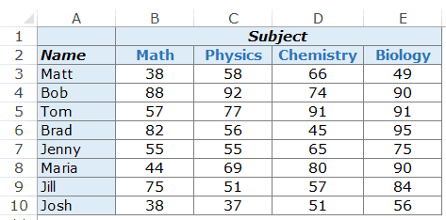
Data Analytics
What is data
Factual information (such as measurements or statistics) used as a basis for reasoning, discussion, or calculation
Any set of characters that is gathered and translated for some purpose, usually analysis. It can be any character, including text and numbers, pictures, sound, or video.
Example of data
OR
If data is not put into context, it means little or nothing to a human…
… and that is where data analytics comes into play

Slide 7
Data Analytics
Definition
The science of analysing raw data
Making conclusions about the data
Helping organisations to optimise their performance
Types
Descriptive Analytics – describes what happened
Diagnostic Analytics – focuses on why something happened
Predictive Analytics – focuses on what is likely to happen
Prescriptive Analytics – suggests a course of action
Example Jobs
Data Analyst
Data Scientist
Data Engineer
Data Architect

Slide 8
Data Analyst | Job Defined
Role
Inspects, cleans, transforms, and models data with the objective of discovering useful information, arriving at conclusions, and supporting the decision making process
Education
Bachelor’s degree in Mathematics, Statistics, Computer Science, Information Technology or something closely related.
Some jobs might require master’s level degree
Skills
Analytical Skills – Be able to analyse data and get to a conclusion
Communication Skills – Be able to present your findings to the business in a way it will understand
Critical Thinking – look at the numbers, trends, and data in order to formulate conclusions
Attention to Detail – need to be attentive in their analysis to come to correct conclusions
Mathematics/Statistics Skills
Programming Skills
Querying and Scripting Language Skills – SQL, XML, Javascript
Data visualization and reporting techniques

Slide 9
Data Scientist | Job Defined
Role
Provides meaningful information based on large amounts of complex data usually within Big Data. Data science, or data-driven science, combines different fields of work in statistics and computation in order to interpret data for the purpose of decision making
Education
Bachelor’s degree in Mathematics, Statistics, Computer Science, Information Technology or something closely related.
Some jobs might require master’s level degree
Skills
Analytical Skills – Be able to analyse data and get to a conclusion
Communication Skills – Be able to present your findings to the business in a way it will understand
Critical Thinking – look at the numbers, trends, and data in order to formulate conclusions
Attention to Detail – need to be attentive in their analysis to come to correct conclusions
Mathematics/Statistics Skills
Programming Skills
Querying and Scripting Language Skills – SQL, XML, Javascript
Data visualization and reporting techniques
Machine learning tools and techniques, unstructured data techniques

Slide 10
Data Engineer | Job Defined
Role
Manages exponential amounts of rapidly changing data. They focus on the development, deployment, management, and optimization of data pipelines and infrastructure to transform and transfer data to data scientists for querying
Education
Bachelor’s degree in Computer Science, Information Technology, Software Engineering or something closely related.
Skills
Database Knowledge
Professional Certifications
Querying and Scripting Language Skills
Programming Skills

Slide 11
Data Architect | Job Defined
Role
Creates/designs set of rules, policies, standards and models that govern and define the type of data collected and how it is used, stored, managed and integrated within an organization and its database systems. They provide a formal approach to creating and managing the flow of data and how it is processed across an organization’s IT systems and applications
Education
Bachelor’s degree in Computer Science, Information Technology, Computer Engineering or something closely related.
Skills
Database Knowledge
Professional Certifications
Querying and Scripting Language Skills
Knowledge in Database Management System Software such as Microsoft SQL Server
Back Up and Security Skills
Information Management and Data Processing on Multiple Platforms
Programming Skills

Slide 12
Careers in I.T. Business Analysis

Slide 13
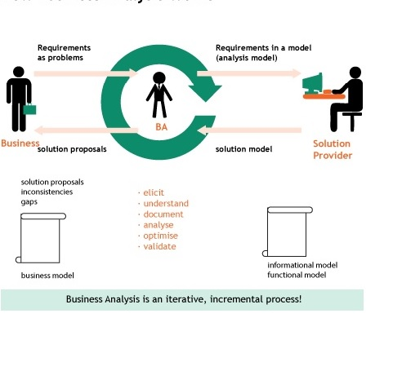
Business Analyst
Someone who is a part of the business operation and works with Information technology to identify, analyse a problem, improve the quality of the services being delivered, sometimes assisting in Integration and Testing of new solutions
Teams Business analysis involve
How Business Analysis Work
Business Analyst
System Architect
Software Developer
Analytics
Specialist
Business Intelligence Analyst
Other

Slide 14
Business Analyst | Role in various business areas
System Architect
Assist in identifying systems that impact business processes and relationships thereof.
Business Intelligence Analyst
Identifies and helps with reporting requirements that aid the business with decision making
Software Developer
Identifies and analyses a business problem that needs developers to address
Analytic Specialist
Assist in identifying data sources where data can be extracted to answer specific business questions

Slide 15
Careers in I.T. Software Engineering

Slide 16
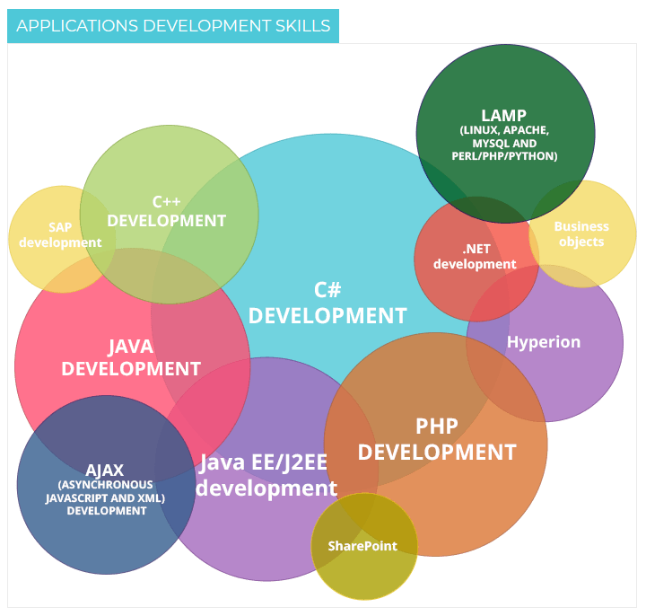
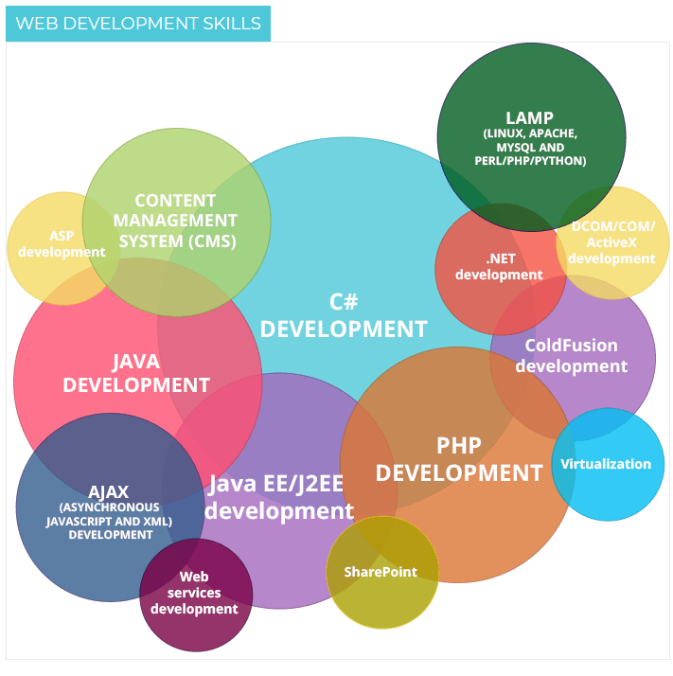
Software Developer / Engineer
Software engineers design, develop and improve upon the computer programs we use every day, including business apps, operating systems, network control systems and social networks
Applications software engineers analyze an end-user's needs and develop a custom program to meet those needs
Systems software engineers coordinate the creation, maintenance and expansion of an organization's internal computer systems
Qualifications
Diploma & Degree Informatics, App Development, Computer Science, & IT
Entrance Req Dip: NSC Dip with Engl HL/FAL 3 and Maths 3/Maths Lit 5 AND two 20 credit subjects (not more than one lang)
Degree: NSC Deg with Maths 5 and Engl and LO 4 and Agric Sci or Life Sci or Phys Sci 4 Duration: Between 3 and 4 Years

Slide 17
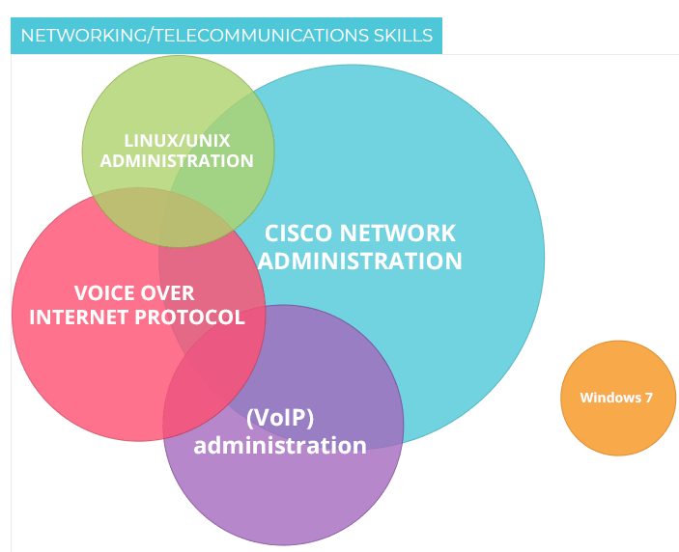
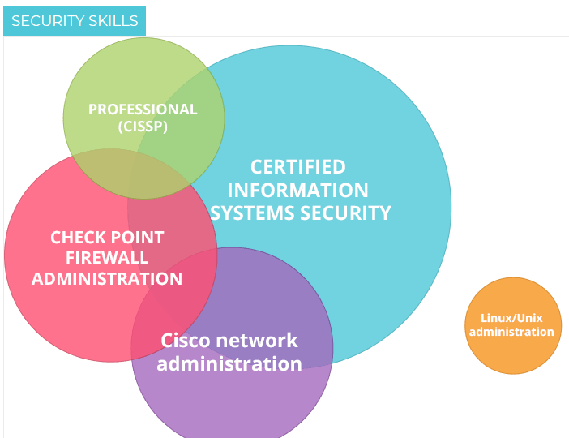
Network Architect / Engineer
Network Engineers who build and repair it, Network Architects are responsible for the planning and design of data and communications networks
The responsibilities of these roles will overlap in some organizations, especially in startups and SMBs, however most enterprises and government agencies employ specialized professionals (or teams of professionals) in each position
Qualifications
Diploma & Degree Computer Science, Computer Systems, Electrical Engineering, & Electronics
Degree Req.: NSC Deg with Maths and Phys Sci 6 and Engl and LO 4 and two subjects from the designated list
Diploma Req. : NSC Dip with Engl HL 3/FAL 4 AND Maths 4 AND Phys Sci 4
FET Certificate Req. : NSC Dip with Home Lang 4 and FAL 3 and Maths and Phys Sci 3

Slide 18

Computer Support Specialist
Computer support specialists help with log-in difficulties, operating system and software malfunctions and some even need to pull out a screwdriver to open up a laptop or PC
Considering the number of phone calls, face-to-face meetings, emails and, in some cases, chats they engage in on a daily basis, people in this line of work must exhibit excellent communication skills
They need to ask users the right questions to pinpoint the issue, find a solution and then guide them step by step through the fix
Qualifications
Diploma in IT Desktop Support or FET certificate
Diploma Req.: NSC Dip with Engl 3 & Maths 3/Maths Lit 4 Diploma Duration: 3 Years FET certificate Req. : NSC H Cert
Certificate Duration: 1 year

Slide 19
Careers in I.T. Robotics, Software Tester

Slide 20

Robotics Engineer
Robot engineer is a person who works on the design, construction, operation, and use of robots, as well as computer systems for their control, sensory feedback, and information processing.
Electrical Component
Mechanical Component
Software Component

Slide 21
Robotics Engineer | Software Engineer
Software Engineer is someone who develops and apply state-of-the-art technologies in sensing, actuation, planning, design, and system verification & validation to bring innovative robot prototypes to life
Courses
Computer Science
Information Technology
Where to study
College
University

Slide 22
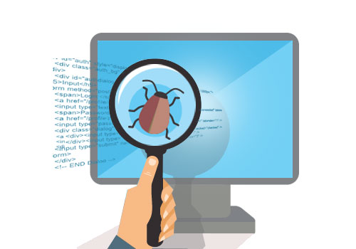
Software Tester
Software tester is someone who does automated and manual tests to ensure the software created by developers is fit for purpose and any bugs or issues are removed within a product before it gets deployed to everyday users
Manual Tester
Automation Tester

Slide 23
Software Tester | Automation Tester
Automated testing is when a tester develops a program that using integrate automation tool to execute test case suites.
Courses
Computer Science
Information Technology
Where to study
College
University

Slide 24
Software Tester | Manual Tester
Manual testing is when a tester manually executes test case suites.
Courses
Computer Science
Information Technology
Where to study
College
University
Multimedia

